Slide 1
Chapter Five
Secondary Storage Management

Slide 2
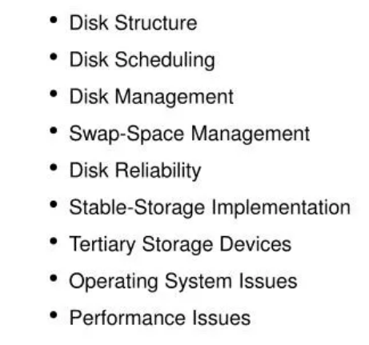
Secondary Storage Management

Slide 3
Secondary Storage Management
Secondary Storage Management covers various aspects related to the management of secondary storage devices, such as disks, in a computer system.

Slide 4
Disk Structure
The disk structure refers to the physical organization and layout of data on a storage device, such as a hard disk drive (HDD) or solid-state drive (SSD). Understanding the disk structure is essential for efficient data storage, retrieval, and management.
Platters and Heads: Disks consist of multiple platters (circular disks) coated with a magnetic material. Each platter has two surfaces, and data is recorded on these surfaces using read/write heads.
Tracks and Sectors: The surfaces are divided into concentric tracks, and each track is further divided into sectors. Sectors are the smallest addressable units and are typically 512 bytes.
Cylinders: A cylinder is the set of all tracks at the same arm position across all platters. Accessing all tracks in a cylinder requires minimal head movement.
Notes:
Disk drives are addressed as large 1-dimensional arrays of logical blocks, where the logical block is the smallest unit of transfer.

Slide 5
Disk Scheduling
Disk scheduling is a crucial aspect of operating systems and storage management, particularly in the context of hard disk drives (HDDs).
It involves determining the order in which I/O requests from various processes are serviced to minimize the overall seek time and optimize the performance of the disk.
Seek time refers to the time it takes for the disk arm to position the read/write heads over the desired track.
Disk scheduling algorithms manage the order in which I/O requests are serviced to optimize disk performance.
Common disk scheduling algorithms include First-Come-First-Serve (FCFS), Shortest Seek Time First (SSTF), etc.

Slide 6
Disk scheduling algorithms
First-Come-First-Serve (FCFS)
Requests are serviced in the order they arrive. The disk arm moves to the location of the first request in the queue and processes subsequent requests sequentially.
Advantage: Simple and easy to implement.
Disadvantage: May lead to poor performance, especially if there are requests located far from each other, resulting in high seek times.
Shortest Seek Time First (SSTF)
The request with the shortest seek time is serviced first. The disk arm moves to the location that minimizes the distance it needs to travel.
Advantage: Reduces seek time compared to FCFS.
Disadvantage: May result in starvation for some requests if there are frequently arriving requests near the disk arm's current position.

Slide 7
Disk scheduling algorithms
SCAN (Elevator) Algorithm
The disk arm moves back and forth across the disk, servicing requests in its path. When it reaches the end, it reverses direction.
Advantage: Prevents starvation and provides a more balanced approach to servicing requests.
Disadvantage: Requests at the extremes may experience longer wait times.
C-SCAN (Circular SCAN)
Similar to SCAN, but the disk arm only moves in one direction (circular fashion). It services requests in its path and jumps to the other end when it reaches the end.
Advantage: Provides a more predictable and fair approach to servicing requests.
Disadvantage: Requests near the jumping point may experience longer wait times.

Slide 8
Disk scheduling algorithms
LOOK Algorithm
Similar to SCAN, but the disk arm only moves as far as the last request in its path. It reverses direction without going all the way to the end.
Advantage: Reduces seek time compared to SCAN.
Disadvantage: May lead to increased head movement if requests are frequently arriving at the extremes.
C-LOOK (Circular LOOK)
Similar to LOOK, but the disk arm only moves in one direction (circular fashion). It reverses direction without going all the way to the end.
Advantage: Reduces seek time and provides a more balanced approach to servicing requests.
Disadvantage: Requests near the jumping point may experience longer wait times.

Slide 9
Disk scheduling
The operating system is responsible for using hardware efficiently. For disk drives, this means having a fast access time and disk bandwidth.
Access time has two major components
Seek time is the time for the disk to move the heads to the cylinder containing desired sector.
Rotational latency is the additional time waiting for the disk to rotate the desired sector to the disk head.
Minimize seek time
Seek time is approximated to seek distance
Disk bandwidth is the total number of bytes transferred divided by the total time between the first request for service and the completion of the last transfer.

Slide 10
Disk Management
Disk management encompasses various activities related to the administration, organization, and maintenance of storage devices, particularly hard disk drives (HDDs) and solid-state drives (SSDs). This includes tasks such as partitioning, formatting, and maintaining file systems.

Slide 11
Disk Management Tasks
Partitioning
Disks can be divided into partitions, which are logical sections of the disk. Each partition may contain a file system or serve a specific purpose.
File Systems
Disk management involves the creation and maintenance of file systems on partitions. Common file systems include FAT32, NTFS (Windows), ext4 (Linux), and HFS+ (macOS).
Formatting
Formatting is the process of preparing a disk or partition for use by creating a file system on it.
Notes:
Master Boot Record (MBR) vs. GUID Partition Table (GPT): Formatting may involve creating either an MBR or a GPT, which are partition table structures used by the disk to manage partitions and boot information.

Slide 12
Disk Management Tasks
Logical Volume Management (LVM)
LVM is a disk management technique that allows dynamic volume resizing, spanning multiple physical disks, and creating snapshots.
LVM provides flexibility in managing disk space, making it easier to resize volumes without significant disruption.
Disk Quotas
Disk quotas allow administrators to limit the amount of disk space a user or group can consume on a file system.
It prevents users from exhausting disk space, ensures fair resource allocation, and assists in managing storage capacity.

Slide 13
Disk Management Tasks
Disk Cleanup
It involves removing unnecessary files and temporary data to free up disk space.
Defragmentation
It involves rearranging fragmented files on a disk to improve read and write speeds.
Mounting
Attaching a file system to a specified mount point in the directory hierarchy, making it accessible to the operating system.
Unmounting:
This is the detaching a file system from its mount point, making it inaccessible. Necessary before removing or ejecting storage devices.
Disk Cloning
Creating an exact copy of a disk onto another disk.
Disk Imaging:
Creating a compressed, single-file representation of an entire disk or partition for backup or migration purposes.

Slide 14
Disk Management Tasks
RAID Configuration
RAID (Redundant Array of Independent Disks) configurations involve grouping multiple disks to enhance performance, provide fault tolerance, or both.
Disk Encryption
Disk encryption involves securing data on a disk by converting it into unreadable code that can only be decrypted with the appropriate key or password.
Purpose: Protects sensitive data from unauthorized access, especially in the event of theft or loss.
NOTE
Effective disk management is essential for maintaining system performance, ensuring data integrity, and optimizing storage resources.

Slide 15
Swap space management
Swap space management is a critical aspect of operating systems, particularly in scenarios where physical random-access memory (RAM) may be insufficient to accommodate all the active processes.
Swap space is a reserved area on the disk used as virtual memory when physical RAM is insufficient. It helps prevent system slowdowns due to memory shortages.
Page Swapping: Operating systems move pages of memory between RAM and swap space based on demand.
Swap File: A dedicated file on an existing file system used as swap space.
Swap Partition: A separate partition on a disk dedicated to swap space.

Slide 16
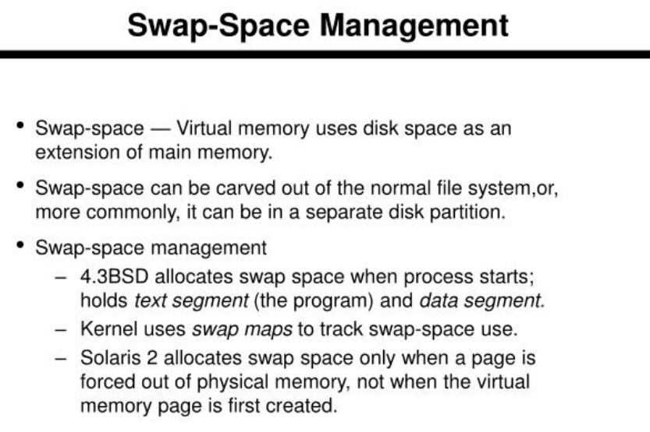

Slide 17
Disk Reliability
Redundancy: Redundant arrays of independent disks (RAID) are used to enhance disk reliability. Different RAID levels provide varying degrees of redundancy and performance.
Error Detection and Correction: Disk controllers and file systems often employ error-detection and error-correction mechanisms to ensure data integrity.
SMART (Self-Monitoring, Analysis and Reporting Technology): SMART is a technology that monitors the health of a hard disk, predicting potential failures based on various parameters.

Slide 18
Backup and Recovery
Backup Strategies: Secondary storage management involves implementing backup strategies to protect against data loss. Regular backups ensure that data can be restored in case of accidental deletion, hardware failure, or other issues.
Recovery Procedures: Having recovery procedures in place is essential to restore the system to a functional state after a failure or data loss event.
Storage Virtualization:
Storage virtualization abstracts physical storage resources, allowing them to be managed as a single, virtualized pool.
Simplifies storage management, improves flexibility, and enables features such as dynamic allocation and migration of storage resources.
Effective secondary storage management is critical for ensuring data availability, performance, and reliability in computer systems.

Slide 19
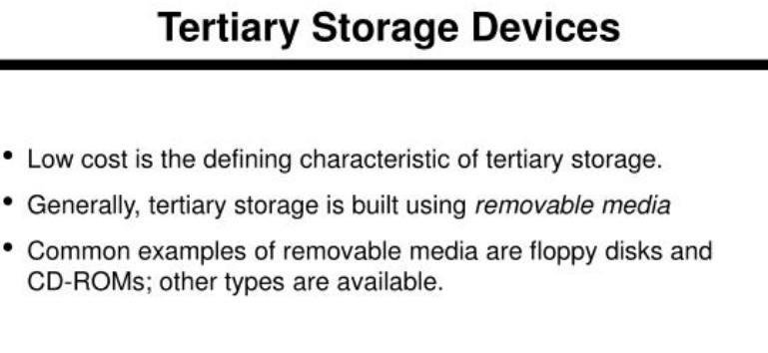

Slide 20
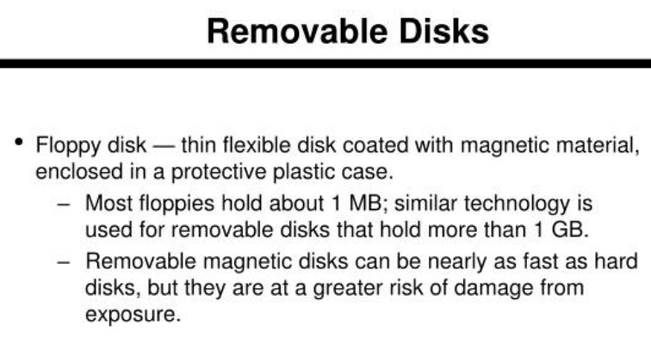

Slide 21
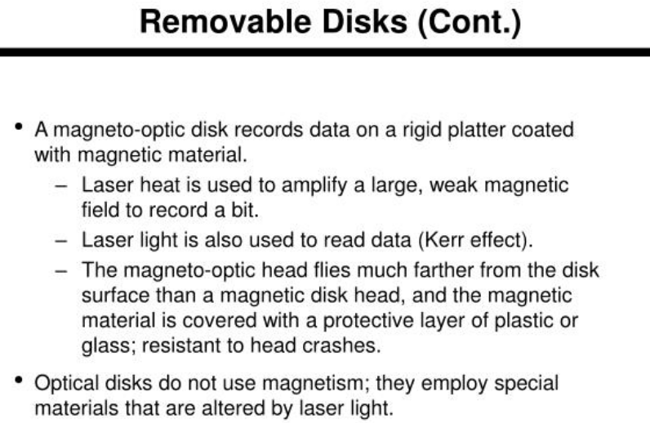

Slide 22
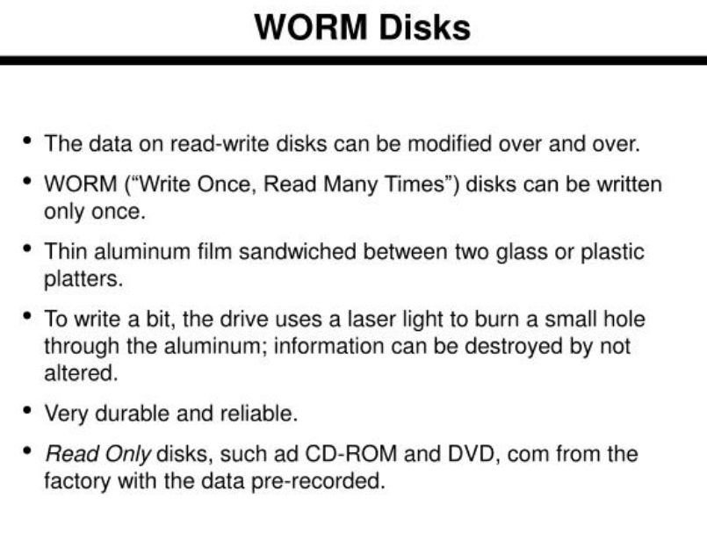

Slide 23
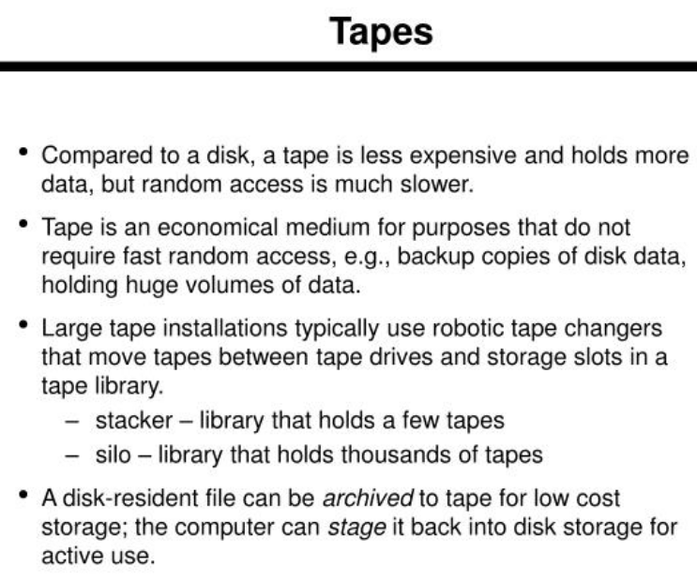

Slide 24
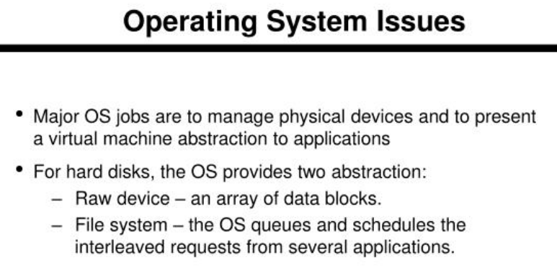

Slide 25
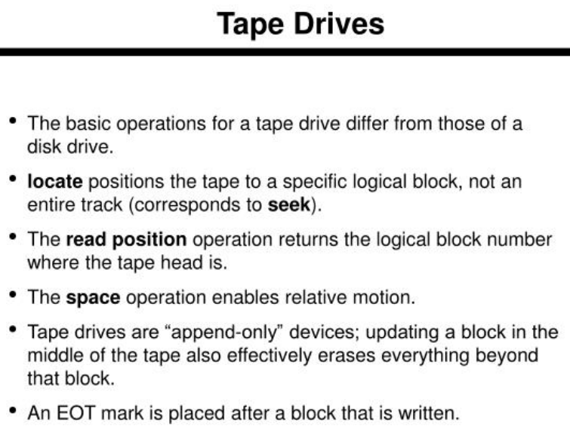

Slide 26
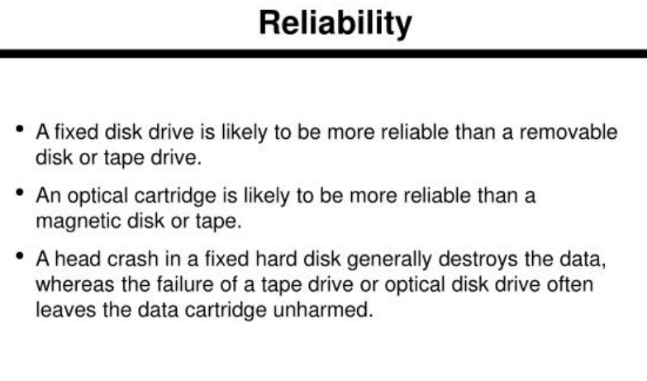

Slide 27
